Slide 1
Exception Handling and Error Management

Slide 2
After this lesson, you will be able to:
2
• Understand what exceptions and errors are in PHP
• Use try, catch, and finally for safer code
• Create your own Exception
• Apply best practices for error handling
Notes:
Why do you think it’s important to handle errors instead of letting PHP display them?

Slide 3
What Is Exception Handling?
3
• An exception is an unexpected event that interrupts normal program flow
• Example: file not found, division by zero, or database error
Notes:
<?php
try {
$a = 10;
$b = 0;
$result = $a / $b; // Will trigger DivisionByZeroError
echo $result;
} catch (DivisionByZeroError $e) {
echo "Error: " . $e->getMessage();
}
?>

Slide 4
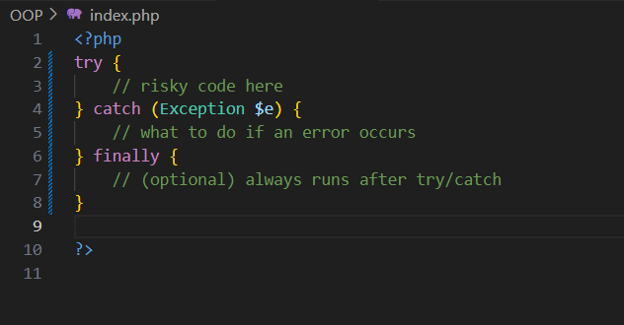
Basic Syntax – try, catch, finally
4
• try — place the code that might cause an error
• catch — handles the error if it happens
• finally — runs always, even if no error
Notes:
<?php
try {
$num1=10;
$num2=0;
$results=$num1/$num2;
} catch (DivisionByZeroError $e) {
echo $e->getMessage();
} finally {
echo "Program is Finished";
}
?>
<?php
try {
$age = -1;
if ($age < 0) {
throw new Exception("Invalid age entered!");
}
echo "Age: $age";
} catch (Exception $e) {
echo "Error: " . $e->getMessage();
}finally{
echo "Program Finished";
}
?>

Slide 5
Built-in Exception
5
Exception | Description | Example
Exception | Base class for all user-defined exceptions | throw new Exception("Error");
DivisionByZeroError | Dividing a number by zero | $x = 10 / 0;
TypeError | Passing the wrong data type to a function | greet(123); when expecting a string
ValueError | Valid type but invalid value | str_repeat("A", -1);
ParseError | Syntax errors in code | Missing ; or unmatched brackets
Throwable | Parent of both Exception and Error — catches both | catch (Throwable $e) { ... }
Notes:
DivisionByZeroError for arithmetic logic
TypeError for function argument checks
Exception for custom error handling
Then introduce Throwable to catch all

Slide 6
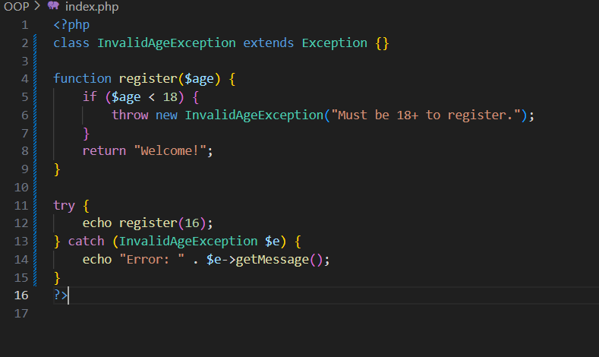
Creating Custom Exceptions
6
Notes:
<?php
class UsernameTooShortException extends Exception {}
function checkUsername($username) {
if (strlen($username) < 5) {
throw new UsernameTooShortException("Username must be at least 5 characters long.");
}
return "Username accepted: $username";
}
try {
echo checkUsername("Jay"); // Invalid, too short
} catch (UsernameTooShortException $e) {
echo "Custom Error: " . $e->getMessage();
}
?>

Slide 7
Best Practices in Error Handling
7
Practice | Description
Use specific exception classes | Create different custom exceptions for different errors
Catch only what you can handle | Avoid catching exceptions if you can’t handle them properly
Use finally for cleanup | Always use finally to close files, DB, or show a message
Avoid silent fails | Never catch errors without logging or notifying
Use Throwable if needed | Syntax errors in code
Throwable | Catch any type of error/exception in one block
Notes:
DivisionByZeroError for arithmetic logic
TypeError for function argument checks
Exception for custom error handling
Then introduce Throwable to catch all

Slide 8
Thank You

